Slide 1
Bank Management System
Group Members:-
1.Md. Shah Imran Mazumder (16-31437-1)
2.Tonmoy Roy (16-31632-1)
3.Md. Minhaz Uddin (16-
4. Eman Kumar Saha (16-31418-1)

Slide 2
Introduction
The bank management system is an application for maintaining a person’s account in the bank.
The system provides
Employee’s Personal Information
Employee’s Official Information
Departmental Information
Branch Information

Slide 3
Business Rule
The purpose of this system is to monitor the employee’s information as well as their working information.
Enhance business performance
Grow customer relationships
Increase Profitability

Slide 4
Business Requirements
Concerning the Emp_info:
1. Emp_info has a primary key EMP_ID and a specific date of birth.
2. Emp_info indicates multivalued phone number .
3. Emp_info has a unique email address.
Concerning the Emp_office:
1.Emp_office has a foreign key emp_id & also hire_date.
2.Emp_office has two not null attributes named ‘deptno’ & ‘branch_no’
Concerning the Department :
1. Department has a primary key deptno.
Concerning the Branch:
1. Branch has a primary key branh_no.

Slide 5
Integrity Constraints
Emp_info has two constraints named ‘primary key’ & ‘unique key’ & also has three not null constraints.
Emp_office has a foreign key constraint .
Department has only one primary key constraint .
Branch has a primary key constraint .

Slide 6
ER-DIAGRAM

Slide 7
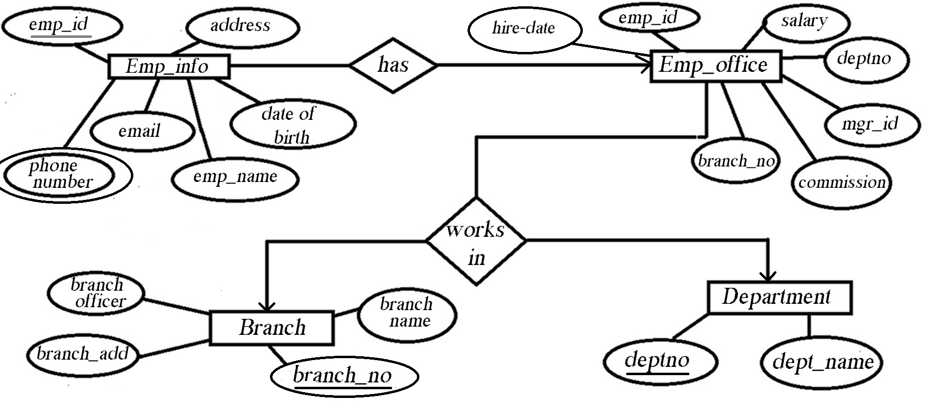

Slide 8
Report

Slide 9
The bank management system is to distribute or maintaining bank information. This bank has more than one branch and has same number of department. In every department, employee’s are working daily by maintaining the system. This system is to distribute work according to their department and there are managers to to check that. To maintain all these, 4 tables were created. In this table,emp_office is the main table because this is the only department where every table is connected. By using emp_id from this table, we can collect employees information. We also used deptno and branch_no attribute to collect information about department from department table and branch information from branch table.

Slide 10
NORMALIZATION

Slide 11
Emp_id ,Emp_name, Phn_no,Address,D_O_B,Email,Sal,Comm,Hiredate,Mgr_id,Branch_no, Branch_name,Branch_add,Branch_officer, Deptno,Dept_name

Slide 12
1NF:
1st table: Emp_id ,Emp_name, Phn_no,Address,D_O_B,Email,Sal,Comm,Hiredate,Mgr_id,Branch_no
2nd table: Branch_no,Branch_name,Branch_add,Branch_officer
3rd table: Deptno,Dept_name,Emp_id
2NF:
1st table: Emp_id ,Emp_name, Phn_no,Address,D_O_B,Email,Sal,Comm,Hiredate,Mgr_id
2nd table: Branch_no,Branch_name,Branch_add,Branch_officer
3rd table: Deptno,Dept_name,Emp_id
4th table: Branch_no , Emp_id

Slide 13
3NF: 1st table: Emp_id ,Emp_name, Ph n_no,Address,D_O_B,Email 2nd table: Emp_id ,Sal,Comm,Hiredate,Mgr_id 3rd table: Deptno,Dept_name,Emp_id 4th table: Branch_no,Branch_name,Branch_add,Branch_officer 5th table : Branch_no , Emp_id

Slide 14
Table Names With Data 1.emp_info 2.emp_office 3.department 4.branch

Slide 15
Emp_info table 48 rows

Slide 16
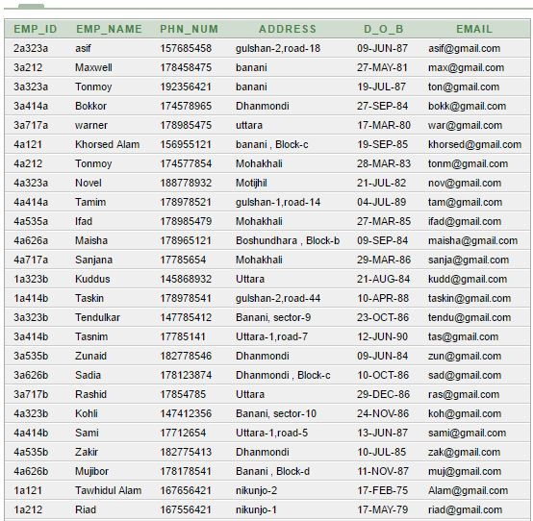

Slide 17
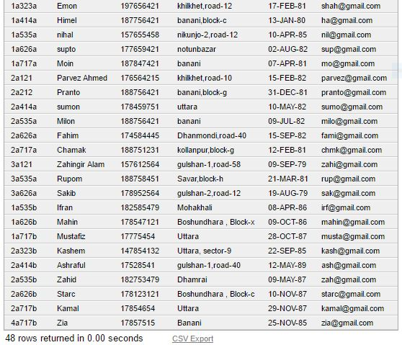

Slide 18
Emp_office table 48 rows

Slide 19
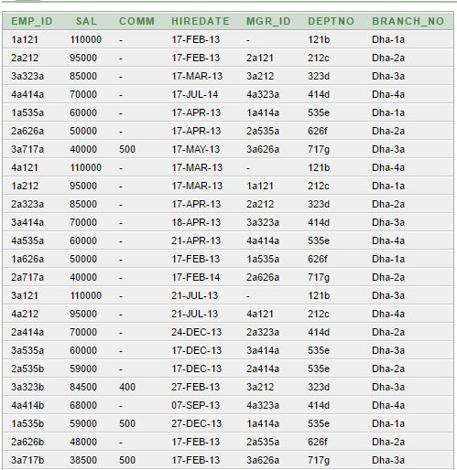

Slide 20
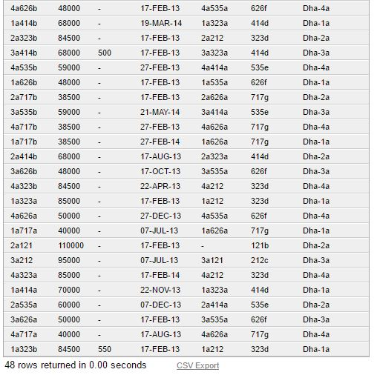

Slide 21
Department table 7 rows

Slide 22
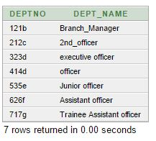

Slide 23
Branch table 4 rows

Slide 24
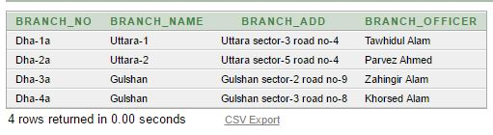

Slide 25
4 view creations with data

Slide 26
Conclusion : Project is about bank management system. This project includes ER-Diagram, Normalization , SQL query This project will help us get and store The employee information of a bank in a safe and secure way.

Slide 27
Simple View

Slide 28
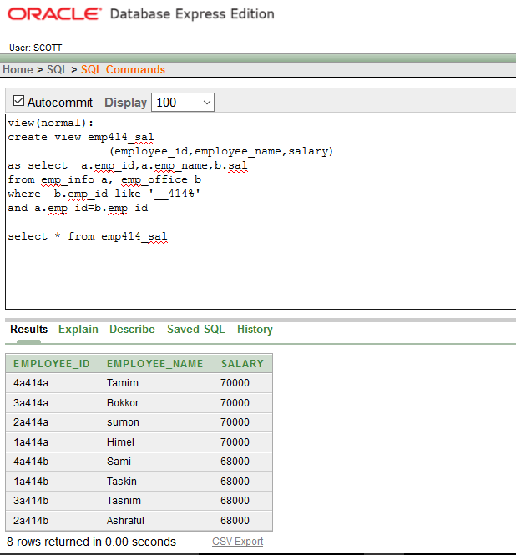

Slide 29
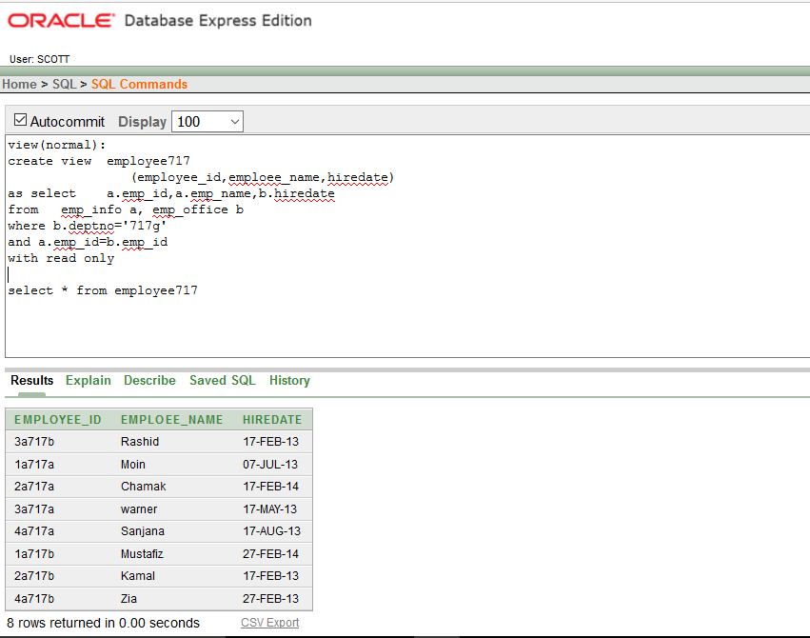

Slide 30
Complex View

Slide 31
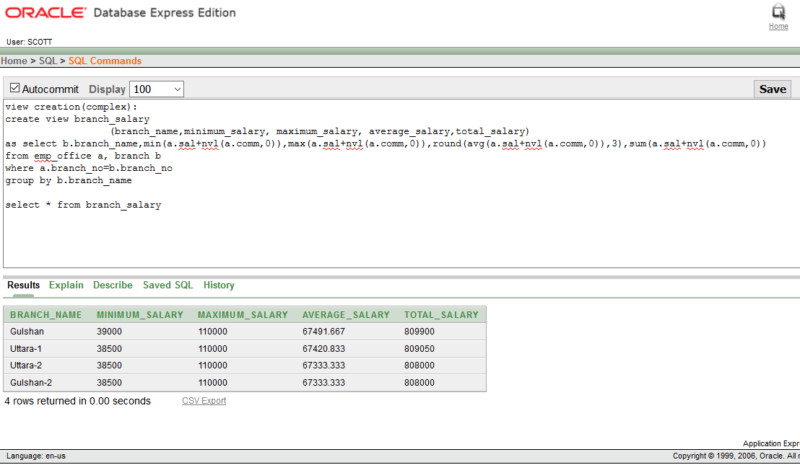

Slide 32
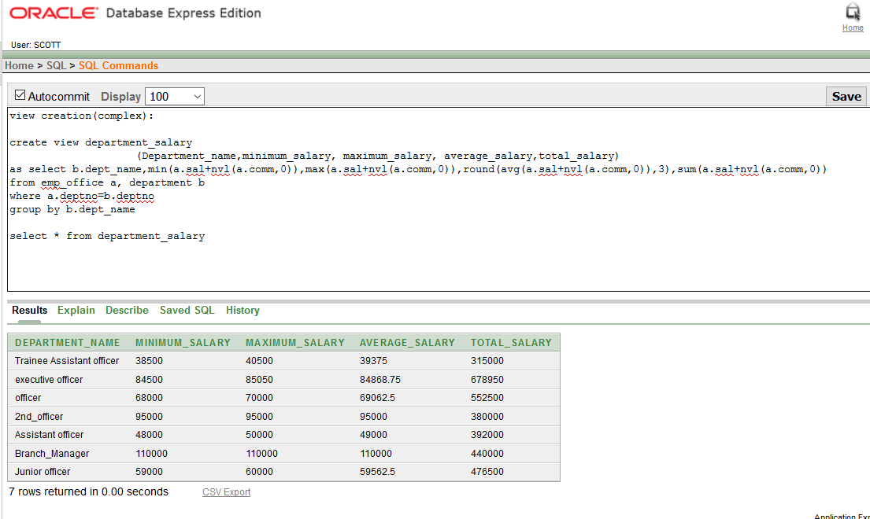

Slide 33
Query with data screenshot 1. Joining Query 2. Sub Query(2 using group function)

Slide 34
Joining Query

Slide 35
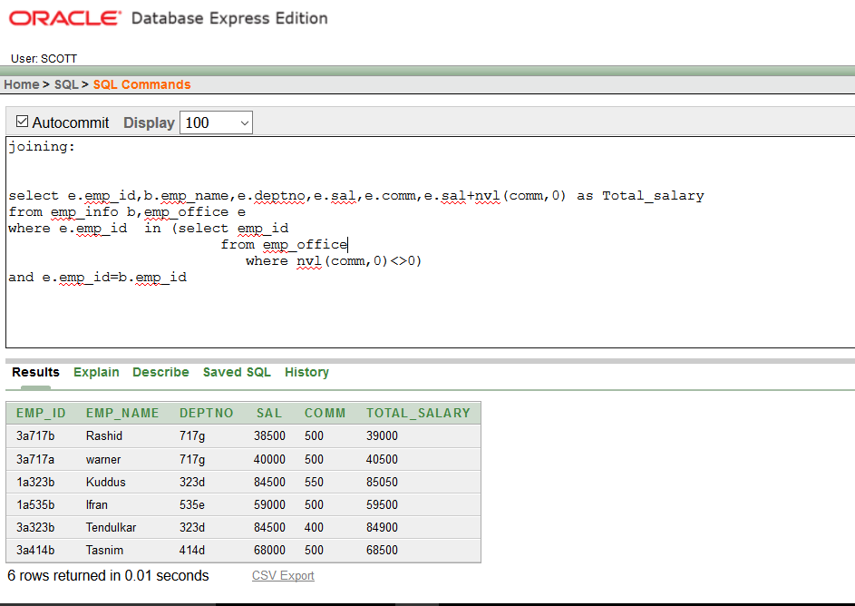

Slide 36
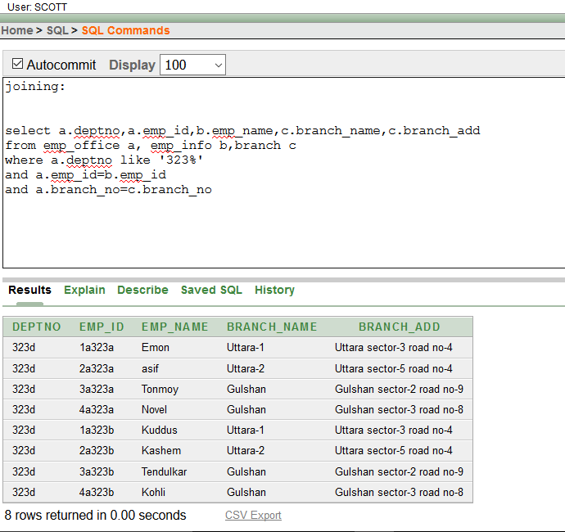

Slide 37
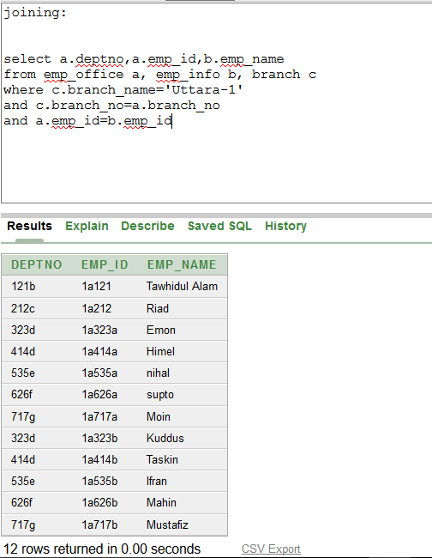

Slide 38
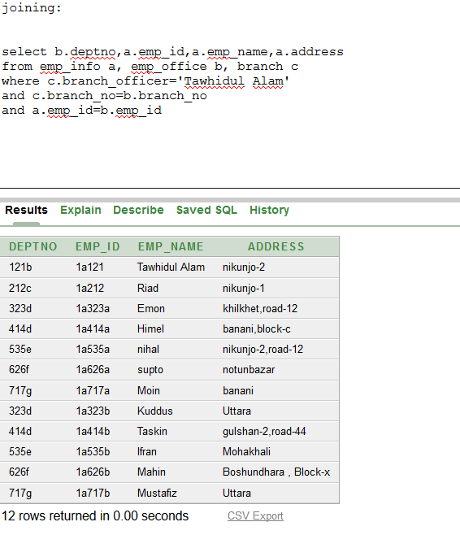

Slide 39
Sub-Query

Slide 40
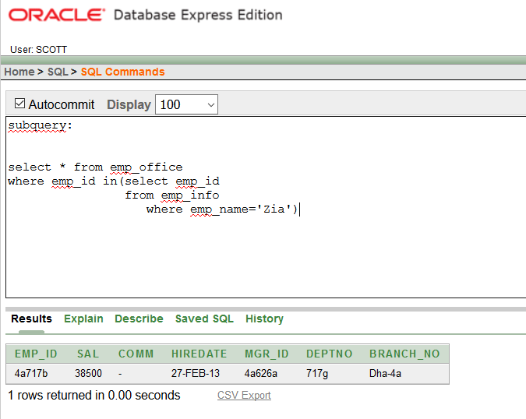

Slide 41
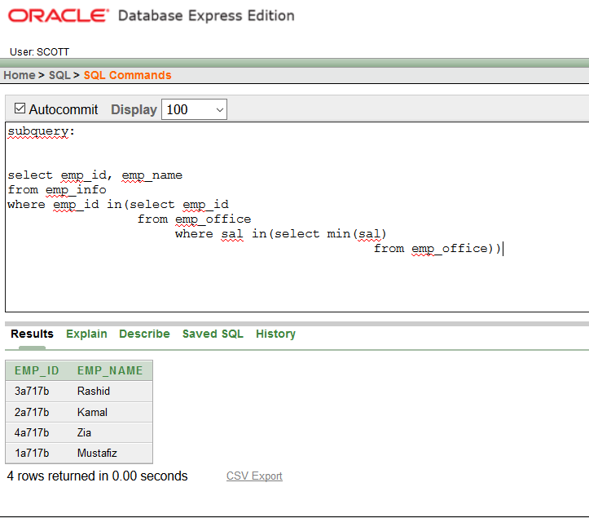

Slide 42
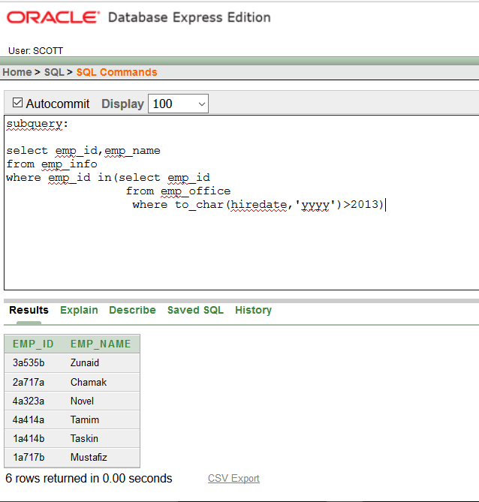

Slide 43
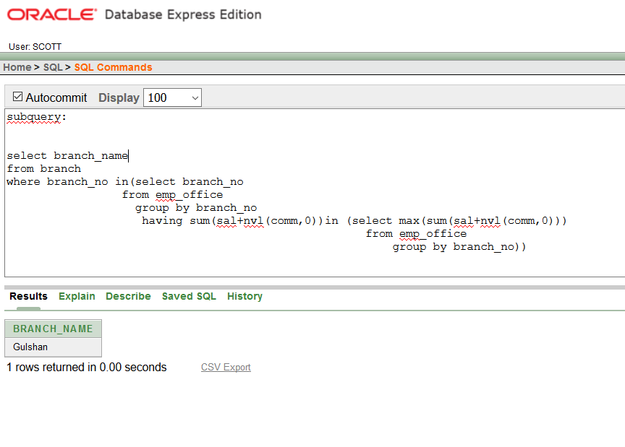

Slide 44
Enable Constraints

Slide 45
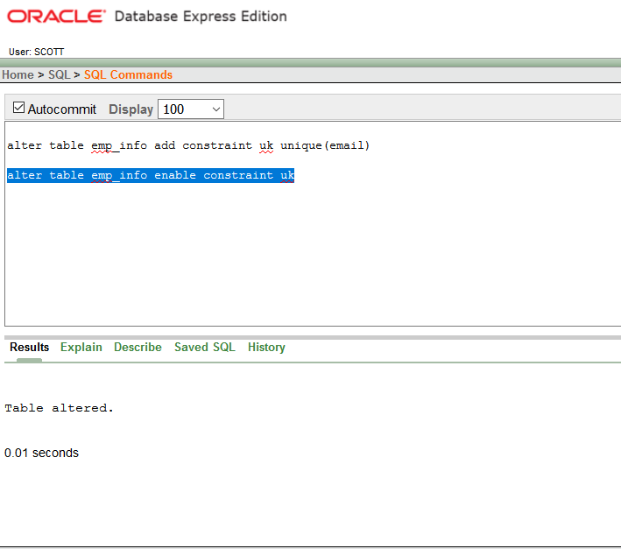

Slide 46
Disable constraint

Slide 47
